Slide 1
ICCT 2026
Interaction Design of a
3D Vehicle Model
for Vehicle Function Control
in Smart Cockpits
A smart-cockpit interaction design study
Presenter: Yinuo Lu
Notes:
25 seconds
ENGLISH
Good morning, everyone. Today I will present our study on 3D vehicle model interaction for vehicle function control in smart cockpits. We ask how a vehicle model can connect physical components with digital controls. I will explain the case findings, the design principles, and the proposed interaction process.
中文
各位老师、各位同行，大家好。今天汇报的是面向车辆功能控制的智能座舱3D车模交互设计研究。我们关注如何通过车辆模型，将实体部件与数字控制入口联系起来。接下来，我将介绍案例发现、设计依据，以及所提出的交互流程。
Source: ICCT2026-2.docx, title and author biography.

Slide 2
01 RESEARCH CONTEXT
Research question and approach
Question, evidence, and method
How can digital controls stay connected
to physical vehicle components?
Qualitative case analysis
Volvo EX30 and Tesla Model 3
ADAC reviews and owner manuals
Research process
01
02
03
Identify problems
Interpret with theory
Translate into design
02
Notes:
Slide 2. Suggested time 45 seconds.
ENGLISH
When doors, lights, and other vehicle functions move into a central display, users must connect a digital entry with a physical component. Menu labels may require searching, and some tasks move between the screen and another control region. Our question is how to make this process more continuous. We use qualitative case analysis of the Volvo EX30 and Tesla Model 3. ADAC reviews identify reported concerns, and owner manuals let us trace the tasks. We then translate the findings into a design proposal grounded in affordance theory, with mapping and feedback as complementary principles.
中文
当车门、车灯等车辆功能进入中控屏，用户需要将数字入口与实体部件建立联系。菜单中的文字标签可能需要查找，部分任务还涉及屏幕与其他控制区域之间的切换。因此，本研究关注如何让操作过程更加连续。我们采用定性案例分析，选取沃尔沃EX30和特斯拉Model 3，以ADAC测评识别已报告的问题，再通过用户手册追踪具体任务。随后，以可供性理论为基础，辅以映射和反馈原则，将案例发现转化为设计方案。
现场提示
用一句话说明问题，再说明资料来源与研究路径。
Source: ICCT2026-2.docx, Sections I and II.A–II.B

Slide 3
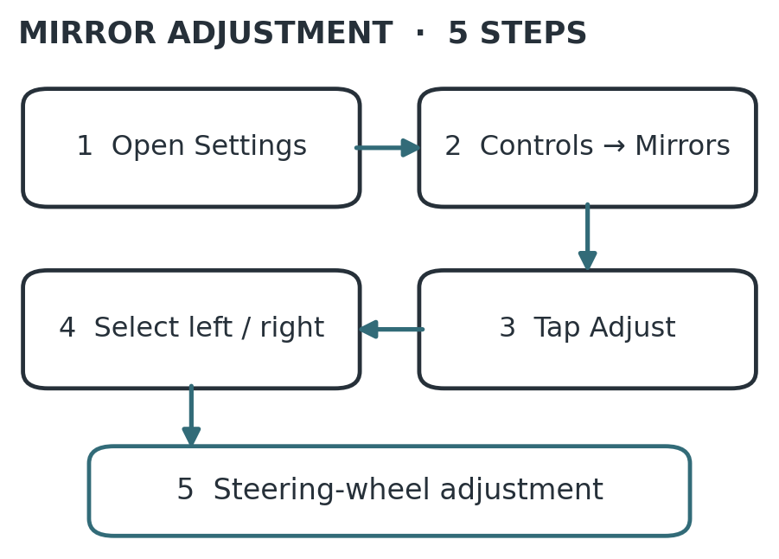
02 CASE FINDINGS
Volvo EX30 mirror adjustment
Case 01 · Volvo EX30
Selection and adjustment
occur in different regions
Screen
Find the mirror entry
and select the target
Steering wheel
Adjust the selected mirror
ADAC operation score: 3.8, lower is better. Paper Figs. 1–2, references [5]–[6].
03
Notes:
Slide 3. Suggested time 45 seconds.
ENGLISH
The Volvo EX30 manual presents mirror adjustment in five steps. Users enter the settings, find the mirror controls, activate adjustment, select a mirror, and then use the steering-wheel controls. Selection and execution therefore take place in different regions. Users must remember which mirror they selected while changing the input location. ADAC also describes menu access and dynamically changing entries. These observations suggest a need for clearer component correspondence, more stable entries, and a visible relationship between selecting a function and carrying out the action.
中文
沃尔沃EX30手册将后视镜调节分为五步：进入设置、找到后视镜控制、激活调节、选择后视镜，最后使用方向盘进行调整。功能选择与实际执行发生在不同区域，用户需要在切换输入位置时，记住所选择的后视镜。ADAC测评还提到菜单入口与动态变化的入口。这些观察说明，界面需要建立更清楚的部件对应，保持入口稳定，并明确呈现功能选择与实际执行之间的关系。
现场提示
顺着五步图讲解，重点强调屏幕与方向盘之间的切换。
Source: ICCT2026-2.docx, Section II.B, Figs. 1–2, references [5]–[6]

Slide 4
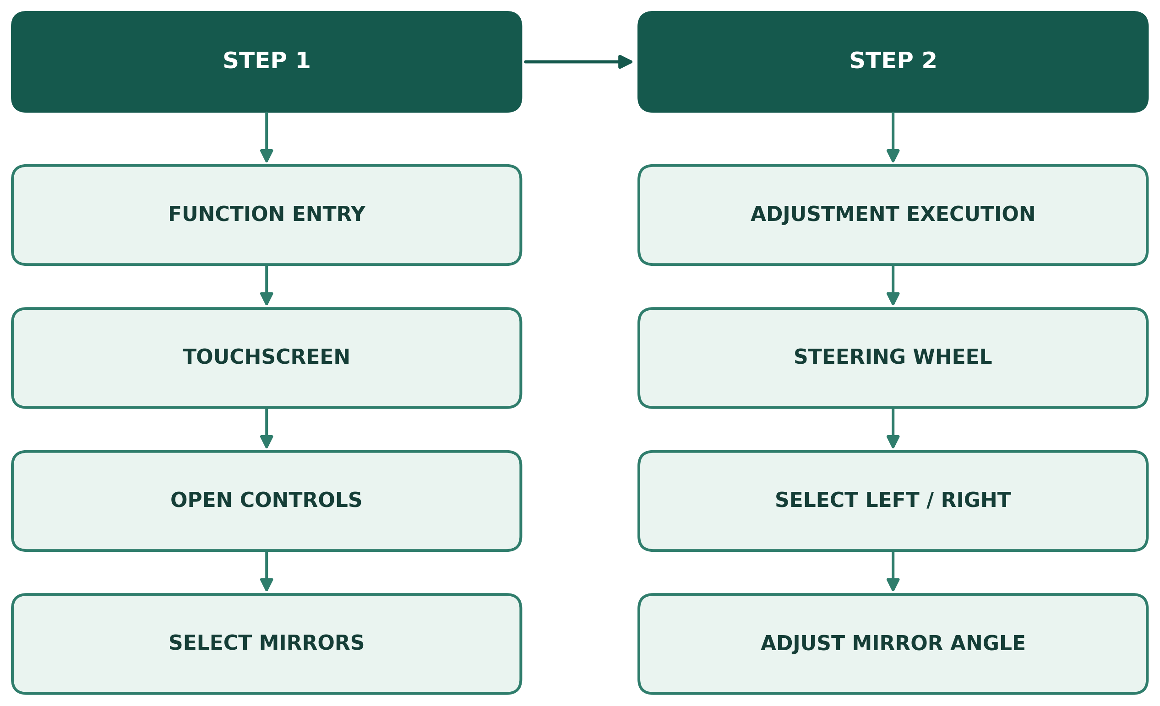
02 CASE FINDINGS
Tesla Model 3 mirror adjustment
Case 02 · Tesla Model 3
One task spans
two control regions
Step 1
Step 2
Function entry
Adjustment execution
Stage 1 Function entry
Touchscreen
Controls > Mirrors
Touchscreen
Steering wheel
Open Controls
Select left / right
Stage 2 Adjustment
Left steering-wheel scroll button
Select a mirror and adjust its angle
Select Mirrors
Adjust mirror angle
ADAC operation score: 3.7, lower is better. Paper Fig. 4, Tesla manual [8].
04
Notes:
Slide 4. Suggested time 50 seconds.
ENGLISH
The diagram separates the Model 3 task into two stages. Stage one is function entry on the touchscreen: open Controls and select Mirrors. Stage two is adjustment on the steering wheel: select the left or right mirror and adjust its angle with the left scroll button. The mirror has a clear physical location, but users first access a text menu and then change control regions. This supports the same design concern as the Volvo case: the interface should make the relationship between the target component, the entry, and the action easier to understand.
中文
这张图将Model 3的后视镜任务分为两个阶段。第一阶段是在触摸屏进入功能，打开Controls并选择Mirrors；第二阶段是在方向盘执行调节，通过左侧滚轮选择左右后视镜并调整角度。后视镜本身具有明确的实体位置，但用户仍需先进入文字菜单，再切换控制区域。它与沃尔沃案例共同指向同一设计问题：界面应让目标部件、功能入口和操作行为之间的关系更容易理解。
现场提示
先指第一阶段，再指第二阶段，不逐框朗读。
Source: ICCT2026-2.docx, Section II.B, revised Fig. 4, reference [8]

Slide 5
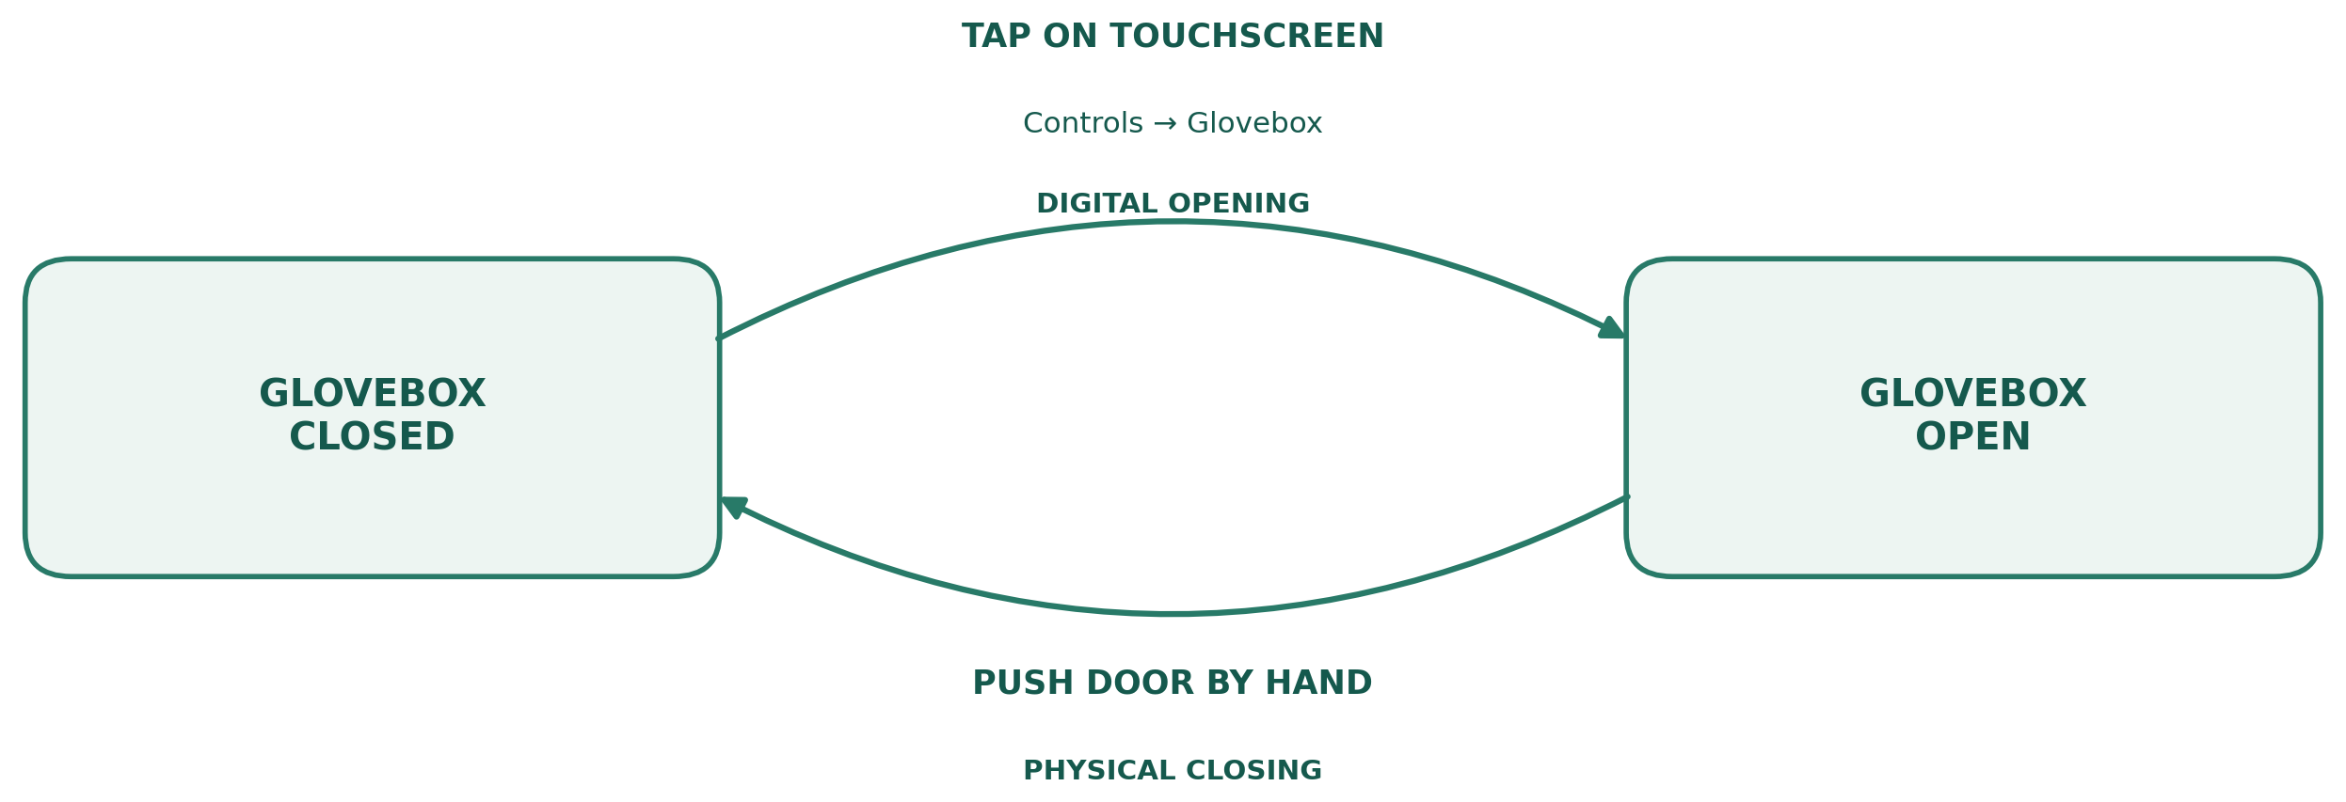
02 CASE FINDINGS
Glovebox input methods
Case 03 · Glovebox input switching
Opening is digital. Closing is physical.
Tap on touchscreen
Controls > Glovebox
Digital opening
Glovebox
closed
Glovebox
open
Push door by hand
Physical closing
Design need: make input rules and component states explicit
Paper Fig. 5, redrawn from the Tesla owner’s manual [8].
05
Notes:
Slide 5. Suggested time 35 seconds.
ENGLISH
The glovebox adds another perspective. Opening uses the touchscreen through Controls and Glovebox, while closing requires pushing the door by hand. The diagram shows these as two directions between closed and open states. This illustrates how one component can involve different input methods. For our proposal, the relevant need is to make action rules explicit and keep state feedback understandable. It does not mean that every combination of digital and physical control is inappropriate.
中文
手套箱提供了另一个观察角度：开启需要在触摸屏进入Controls和Glovebox，关闭则需要用手推动。图中用关闭与开启两种状态之间的双向转换，表达两种输入方式。这说明同一部件的操作可能涉及不同输入方式。对本方案而言，相应需求是明确操作规则，并让状态反馈容易理解，而不是认为所有数字与实体控制的结合都不合理。
现场提示
沿上方箭头讲开启，再沿下方箭头讲关闭。
Source: ICCT2026-2.docx, Section II.B, revised Fig. 5, reference [8]

Slide 6
03 DESIGN TRANSLATION
Design needs and theoretical basis
From findings to design principles
Design need | Theoretical basis | Design response
Discover an action | Affordance and signifiers | Hotspots and outlines
Locate the target | Mapping | Entry at the component
Understand the result | Feedback | State changes and text
A component provides the spatial reference throughout the task
Paper Sections II.A–II.C. Mapping and feedback complement affordance theory [2]–[3].
06
Notes:
Slide 6. Suggested time 55 seconds.
ENGLISH
The cases lead to three related design needs. Users need to discover an available action, locate its target, and understand its result. Affordance theory concerns the actions possible between an actor and an environment. Perceptible cues, which Norman calls signifiers, help users discover those actions. We therefore use hotspots and outlines to show where control is available. Mapping supports spatial correspondence between an entry and a component. Feedback communicates the component state after a command. These principles support different parts of the task. Together, they guide a control process organized around the vehicle component.
中文
案例指向三个相关需求：用户需要发现可用操作、定位目标，并理解结果。可供性理论关注行动者与环境之间可能发生的行动，而Norman所说的能指，是帮助用户发现这些行动的可感知线索。因此，方案通过热点和轮廓提示哪里可以操作；通过映射建立入口与部件的空间对应；通过反馈说明指令之后的部件状态。这些原则分别支撑任务的不同环节，共同指导以车辆部件为中心的控制流程。
现场提示
按表格逐行解释，区分可供性、能指、映射与反馈。
Source: ICCT2026-2.docx, Sections II.A–II.C, references [2]–[3]

Slide 7
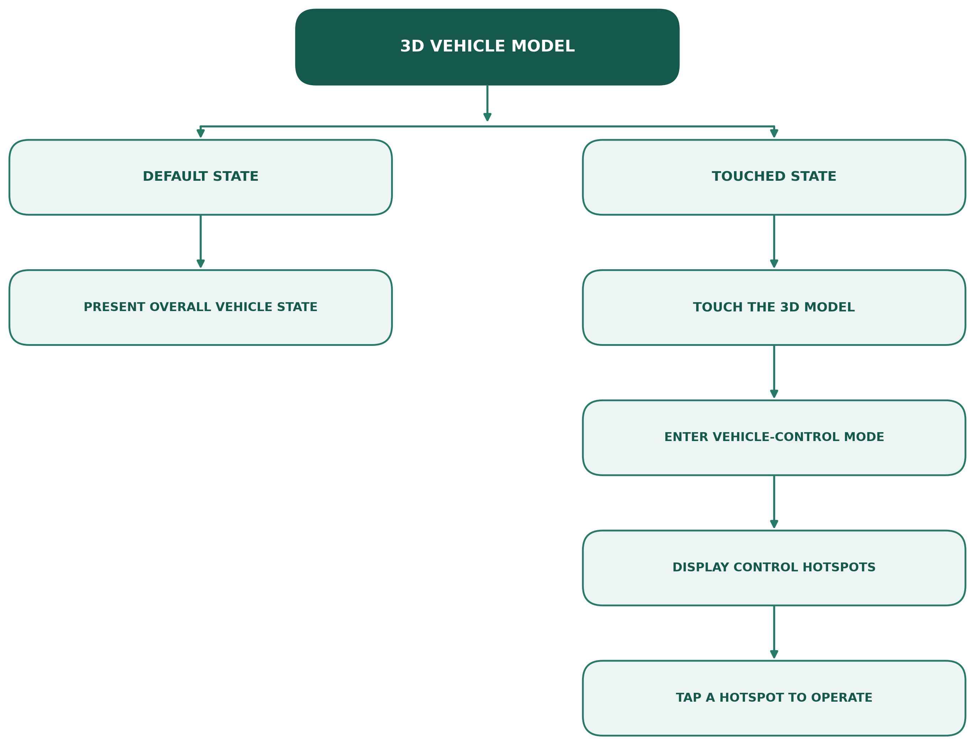
03 DESIGN TRANSLATION
3D model entry logic
One model for status and control
3D vehicle model
Default state
Show the overall vehicle state
Default state
Touched state
After touching the model
Present overall
vehicle state
Touch the 3D model
Enter control mode
Reveal hotspots, then tap to operate
Enter vehicle-control
mode
Display control
hotspots
Menus remain available
Climate and complex settings
retain menu or card entries
Tap a hotspot
to operate
Paper Fig. 7. The model serves both status display and component control.
07
Notes:
Slide 7. Suggested time 55 seconds.
ENGLISH
The flow diagram shows the model's two roles. In its default state, it presents the overall vehicle. When users touch the model, the interface enters vehicle-control mode and displays hotspots. Users can then tap a hotspot to operate the corresponding function. The key design move is to place the entry at the physical component's position. The model therefore becomes both a status display and a control entry. Functions with many parameters or no single clear spatial location, such as climate settings, continue to use menus or cards. This keeps object-based control complementary to conventional controls.
中文
流程图展示了车模的两种作用。默认状态用于呈现车辆整体状态；用户触摸车模后，界面进入车辆控制模式并显示热点，随后点击热点即可操作对应功能。设计的关键，是将入口设置在实体部件对应的位置，使车模同时承担状态展示与功能入口两种作用。对于参数较多，或缺少单一明确空间位置的功能，例如空调设置，仍保留菜单或卡片。这样，对象控制就能够与传统控制方式形成互补。
现场提示
先讲默认状态，再沿右侧流程解释触摸后如何进入操作。
Source: ICCT2026-2.docx, Section III.A, updated Fig. 7

Slide 8
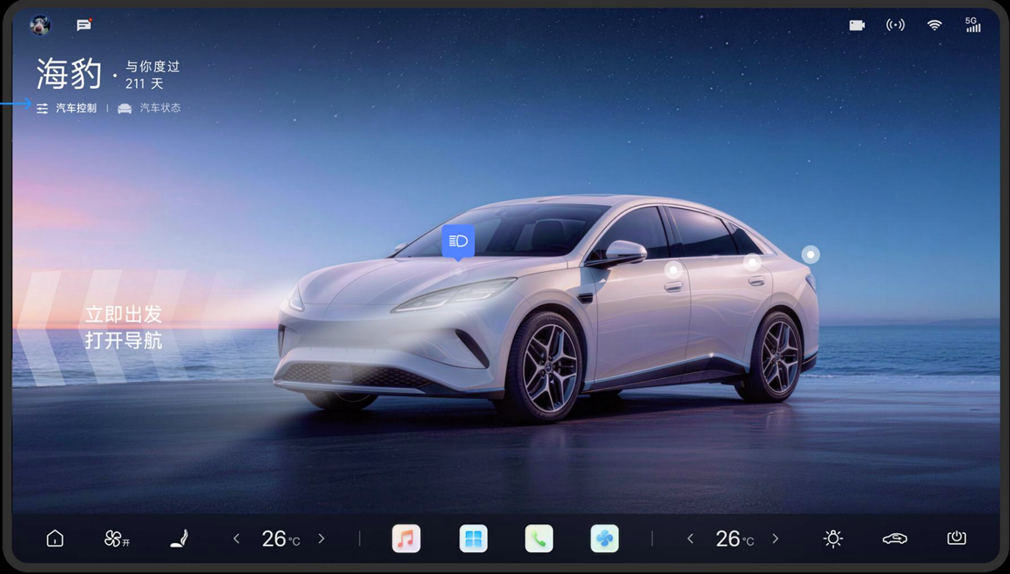
03 DESIGN TRANSLATION
Interface states and visual focus
Three states: viewing, activation, feedback
01 Viewing
Vehicle status
and frequent information
02 Activation
Touch the model
to reveal controls
03 Feedback
Show the selected
component state
Paper Fig. 8. Illustration of the proposed interface and state transition.
08
Notes:
Slide 8. Suggested time 60 seconds.
ENGLISH
This illustration shows the proposed interface. In the default view, the vehicle and frequent information remain prominent. Touching the model reveals component controls, while background cards recede. The visual change helps users recognize that the model now supports control. After an action, the interface communicates the selected component's state. A lamp can show illumination, while a door or trunk can show an angle change, paired with text. The intended sequence is therefore viewing, activation, and feedback. This is a design illustration. It presents the proposed behavior, while actual execution needs reliable vehicle-state information.
中文
这张图展示了所提出的界面。在默认视图中，车辆与高频信息是主要内容。触摸车模后，部件控制入口出现，背景卡片弱化，帮助用户识别车模已经进入控制状态。操作之后，界面呈现所选部件的状态。例如，车灯可以显示点亮，车门或后备厢可以显示角度变化，并配合文字。因此，整体顺序是查看、激活和反馈。这是一张设计示意，展示预期行为；实际执行仍需要可靠的车辆状态信息支持。
现场提示
给观众几秒观察原型图，再按三个状态讲解。
Source: ICCT2026-2.docx, Section III.B, Fig. 8

Slide 9
03 DESIGN TRANSLATION
Input rules and feedback
Tap, long press, and safeguards
Function | Input | Feedback
Lower-risk light controls | Single tap | Illumination and text
Door / trunk opening | Long press | Angle changes and text
Unavailable functions
Keep entries stable, dimmed or accompanied by an explanation
Paper Sections III.B–III.C. Proposed safeguards require evaluation in driving contexts.
09
Notes:
Slide 9. Suggested time 50 seconds.
ENGLISH
The proposal distinguishes inputs according to the consequences of an action. Lower-risk light controls may use a single tap. Door and trunk opening require a long press to reduce accidental activation. Prompts should explain the input before execution, and feedback should remain attached to the selected component. Unavailable functions stay visible in a dimmed form or include an explanation. Major entries also keep their positions as state changes. These rules aim to make actions predictable and results understandable. Their effect on errors and driving safety still requires user testing.
中文
方案根据操作后果区分输入方式。较低风险的车灯控制可以使用单击，车门和后备厢开启则采用长按，以减少意外激活。执行前的提示需要说明输入方式，执行后的反馈应与选中部件保持关联。不可用功能继续以置灰或说明的方式保留，主要入口也不随状态变化而移动。这些规则旨在让操作可以预期、结果容易理解，其对错误率和驾驶安全的影响仍需要用户测试。
现场提示
重点讲单击与长按的区别，避免将防误触措施说成实测成果。
Source: ICCT2026-2.docx, Sections III.B–III.C

Slide 10
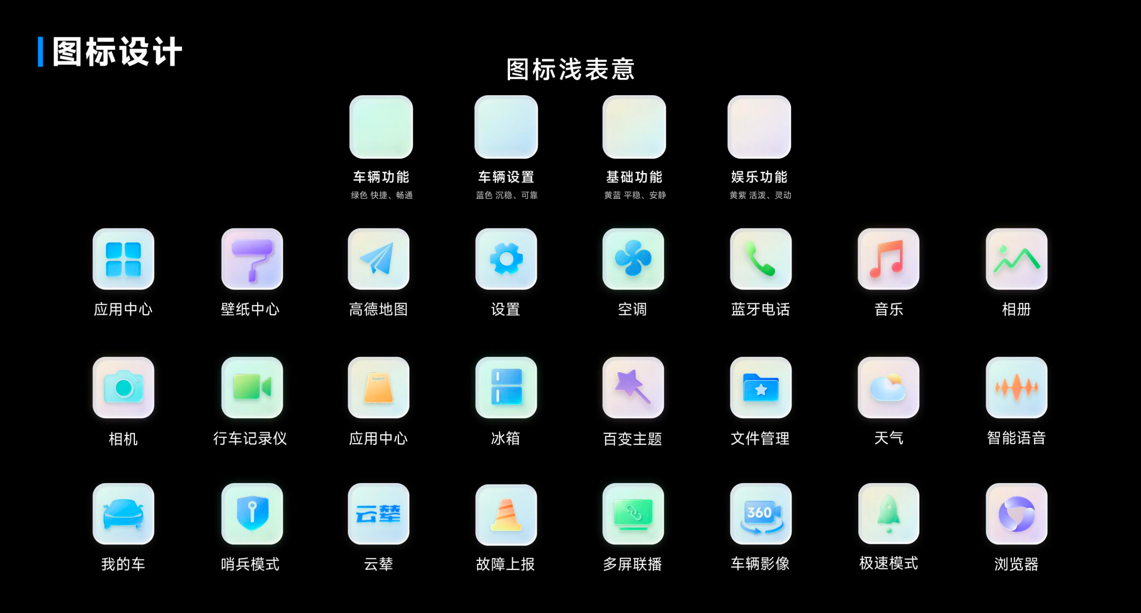
03 DESIGN TRANSLATION
Visual coding and consistency
Icon language, color, and status
Consistent icon language
Categories use moderate color
differences and internal symbols
Separate category and status
Execution states use consistent
expressions paired with text
Paper Fig. 9. Component controls, vehicle parameters, general applications and entertainment.
10
Notes:
Slide 10. Suggested time 40 seconds.
ENGLISH
The icon system supports consistent recognition across the interface. It distinguishes component controls, vehicle parameters, general applications, and entertainment functions. Moderate color differences work with internal symbols, while related functions follow a consistent icon language. Category coding and execution status use separate rules, so one color does not carry conflicting meanings. In-progress, completed, and exception states should use consistent expressions paired with text. This extends consistency from the location of a control to the way its meaning and state appear.
中文
图标系统用于支持整个界面的一致识别。它区分部件控制、车辆参数、通用应用和娱乐功能，利用适度色彩差异与内部符号辅助识别，并保持统一图标语言。功能类别与执行状态采用不同规则，避免同一颜色表达冲突含义。执行中、已完成及异常状态，也应统一表达并配合文字。这样，一致性就从入口位置，进一步延伸到功能含义和状态呈现。
现场提示
以图标示例解释类别编码，不逐个介绍应用。
Source: ICCT2026-2.docx, Section III.C, Fig. 9

Slide 11
04 SCOPE AND CONTRIBUTION
Complementary control modes
Menus vs. 3D model: scope of use
Dimension | Menus | 3D vehicle model
Entry | Labels and categories | Component locations
Feedback | Icons, switches and text | Component changes and text
Best fit | Complex parameter settings | Spatially identifiable functions
Limitation | Potentially deeper search | Accidental activation risk
The task determines the appropriate control mode
Condensed from Table I. Structural comparison, not measured performance.
11
Notes:
Slide 11. Suggested time 40 seconds.
ENGLISH
The comparison defines the scope of the proposal. Menus suit many functions and detailed parameter settings. The 3D model suits components with identifiable locations and visible state changes, including lights, doors, windows, and trunks. It can connect a control with its target, but also introduces accidental-activation risks. We therefore choose the control mode according to the task. This is a structural comparison, rather than evidence that the model performs better in every situation.
中文
这个比较用于界定方案的适用范围。菜单适合承载较多功能和细致参数设置；3D车模适合位置明确、状态变化可见的部件，例如车灯、车门、车窗及前后备厢。它能够将控制入口与目标联系起来，但也存在误激活风险，因此需要根据任务选择控制方式。这里比较的是结构差异，并不意味着车模在所有情况下都表现更好。
现场提示
围绕适用任务讲解，不逐格朗读表格。
Source: ICCT2026-2.docx, Section IV, Table I

Slide 12
04 SCOPE AND CONTRIBUTION
Contribution and next steps
Contribution and future evaluation
A continuous control process
organized around vehicle components
Object location, function activation, execution and state confirmation
share a spatial reference on the 3D model.
Future evaluation
Task time, errors, feedback clarity and driving safety
Thank you
12
Notes:
Slide 12. Suggested time 35 seconds.
ENGLISH
To conclude, this study translates qualitative case findings into a 3D vehicle control proposal. It links object location, function activation, command execution, and state confirmation through spatial mapping and consistent rules. Complex settings remain in menus. The contribution is this organization of controls and feedback. Future testing in driving contexts should assess task time, errors, and the clarity of state feedback, alongside driving safety. Thank you for listening. I welcome your questions.
中文
最后，本研究将定性案例发现转化为3D车辆控制方案，通过空间映射与一致规则，连接对象定位、功能激活、指令执行和状态确认，复杂设置则由菜单承载。研究贡献在于控制入口与反馈关系的组织。后续应在驾驶情境中开展测试，评估操作时间、错误率、反馈清晰度，以及驾驶安全。感谢各位聆听，欢迎交流与指正。
现场提示
概括贡献与局限后结束，留出提问空间。
Source: ICCT2026-2.docx, Section V

