Slide 1

From Live Action to AI-Generated Video:
A Comparative Study of Green-Screen Video-Guided
and Text-Prompt-Based Workflows
Authors: Mengqi Liu, Sunghoon Cho, Yun Ji
Dongseo University, Busan, Republic of Korea
ICCT 2026 · Shanghai, China
Notes:
Hello everyone, my name is Mengqi Liu, and I’m from Dongseo University in Busan, South Korea. This study was under the guidance of Professor Cho and Professor Yun Ji. Our topic is “From Live Action to AI-Generated Video: A Comparative Study of Green-Screen Video-Guided and Text-Prompt-Based Workflows.”

Slide 2
02
Presentation outline
01
Research Motivation
OUTLINE
Storyboard requirements and research question
02
Research Design
Production material, inputs and assessment
Research question
03
Overall Results
Does adding a green-screen video reference help preserve planned storyboard requirements?
Compliance across 30 retained A/B pairs
04
Shot Comparisons
Four examples of framing, motion and presence
05
Discussion and Conclusion
Interpretation, limitations and implications
ICCT 2026
02
Notes:
My presentation has five parts: research motivation, research design, overall results, shot comparisons, discussion and conclusion. Then I will show you our research question behind this study.

Slide 3
03
Research problem and question
Production requirement
A generated shot must preserve the intended composition and unfolding action.
Research question
Does adding a green-screen video reference help preserve planned storyboard requirements?
Scope: a descriptive comparison of retained outputs from one production setting.
ICCT 2026
03
Notes:
Nowadays, making AI-generated videos is more and more convenient. But when we make a video, it is important to follow the storyboard. At the same time, the camera view, character movement, and required characters all matter. A good-looking image alone can’t show whether the complete video meets these requirements. Our question is: Does adding a green-screen video reference help preserve the planned shot design? We explored this question with one production setting.

Slide 4
04
Production material and study scope
Production material | Reported setting
Storyboard tasks | 30 tasks, source IDs S01–S30
Reference filming | Sony FX9, university green-screen classroom
Platform / model | Higgsfield / Seedance 2.5
Output settings | 5 seconds, 1080p, 16:9, 24 fps
Generation period | October 8–11, 2026
Analytical corpus | 30 A/B pairs, 60 videos
ICCT 2026
04
Notes:
This slide shows our production materials and study settings.
We used thirty storyboard tasks. We filmed the green-screen reference videos in a university classroom using a Sony FX9.
We used Higgsfield with Seedance two point five.
Each video was five seconds long, at ten-eighty p, with a sixteen-to-nine aspect ratio and twenty-four frames per second.
We generated the videos from October eighth to eleventh, twenty twenty-six.
For each shot, we generated one video with each workflow. This gave us thirty pairs and sixty videos for analysis.

Slide 5
05
Workflow comparison
Shared inputs: storyboard text and character images linked by @-mentions
Stage | A: with video reference | B: without video reference
Preparation | Film planned framing and action | Use shared text and images
Generation input | Shared inputs + corresponding video | Shared inputs
Generation | Same model and output settings | Same model and output settings
Selection and review | Retain one output, review full clip | Retain one output, review full clip
“Text-prompt-based” includes character images. The planned input difference is the added video.
ICCT 2026
05
Notes:
This slide shows the difference between the two workflows.
Both used the same storyboard text, character images, and generation settings.
Workflow A also received the corresponding green-screen video showing the planned framing and action.
Workflow B received no video reference. It still used character images, even though we call it a text-prompt-based workflow.
We reviewed each complete output against the storyboard.

Slide 6
06
Storyboard-based assessment
Assessment dimension | Observation | Eligible pairs
Framing and viewpoint | Shot scale and viewing direction | 30
Character movement path | Planned path through the shot | 5
Required subject presence | Required characters or body parts | 28
Standard
Predefined storyboard requirements, coded as met or unmet.
Review
Complete clips, assessed by the generating researcher.
ICCT 2026
06
Notes:
We assessed the videos in three dimensions.
First, framing and viewpoint: whether the video followed the planned shot scale and viewing direction. This applied to all thirty pairs.
Second, movement paths: whether the character followed the planned paths. This applied to five pairs.
Third, subject presence: whether the required characters or body parts appeared. This applied to twenty-eight pairs.
Each requirement was marked as met or unmet.
I generated and assessed the videos.

Slide 7
07
Compliance across retained outputs
Requirement | Eligible pairs | A meets | B meets
Framing and viewpoint | 30 | 25 / 30 | 18 / 30
Character movement path | 5 | 4 / 5 | 2 / 5
Required characters or body parts | 28 | 26 / 28 | 21 / 28
A showed higher descriptive compliance in all three dimensions.
B-only successes and shared failures occurred. Counts describe selected outputs.
ICCT 2026
07
Notes:
This table shows the results. For framing and viewpoint, A met the requirement in twenty-five out of thirty tasks, compared with eighteen for B. For movement paths, the counts were four out of five for A and two for B. For required characters or body parts, there were twenty-six out of twenty-eight for A and twenty-one for B. A had higher counts in all three areas in this selected sample. However, B sometimes succeeded where A failed, and both sometimes failed. These counts do not represent first-attempt success rates.

Slide 8
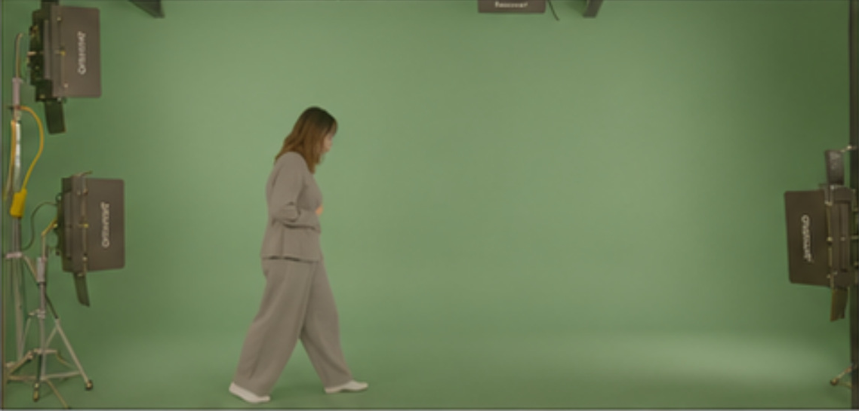
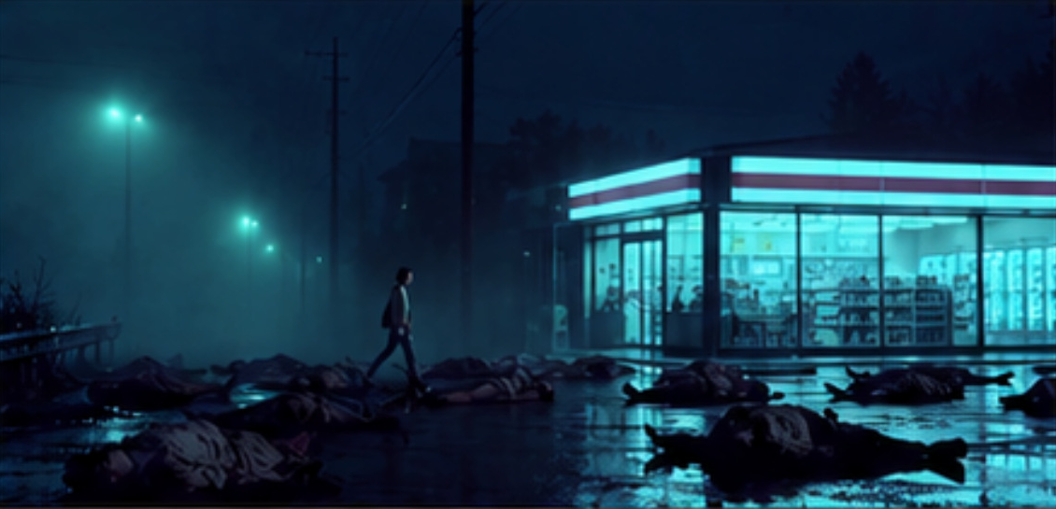
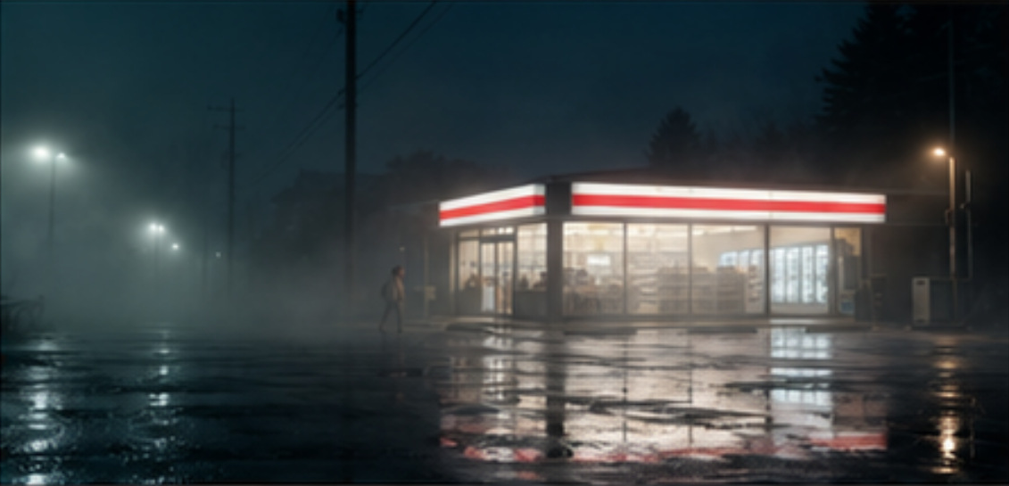
08
Shot 1: walking path
Requirement: an extreme wide shot with straight left-to-right walking
Green-screen source
A: with video reference
B: without video reference
Filmed walking action
A retains the planned
left-to-right movement.
B approaches from the center,
then turns left into the store.
The observed departure in B concerns the movement path.
ICCT 2026
08
Notes:
For Shot 1, our storyboard plan was for the person to enter the frame from the left, walk in a straight line, and leave the frame on the right.
In Workflow A, we added the green-screen video reference. The person followed the path we wanted.
In Workflow B, we did not add a video reference. The person appeared from the fog in the center of the frame, then turned left into the convenience store.

Slide 9
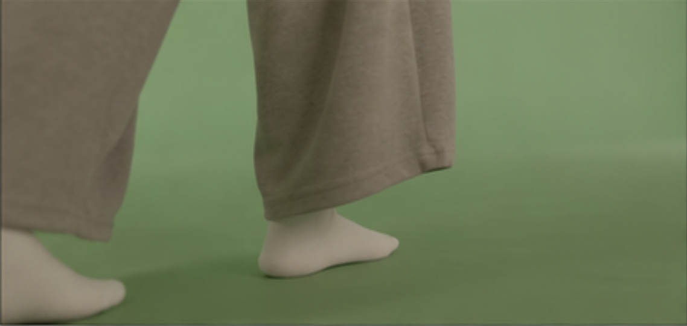
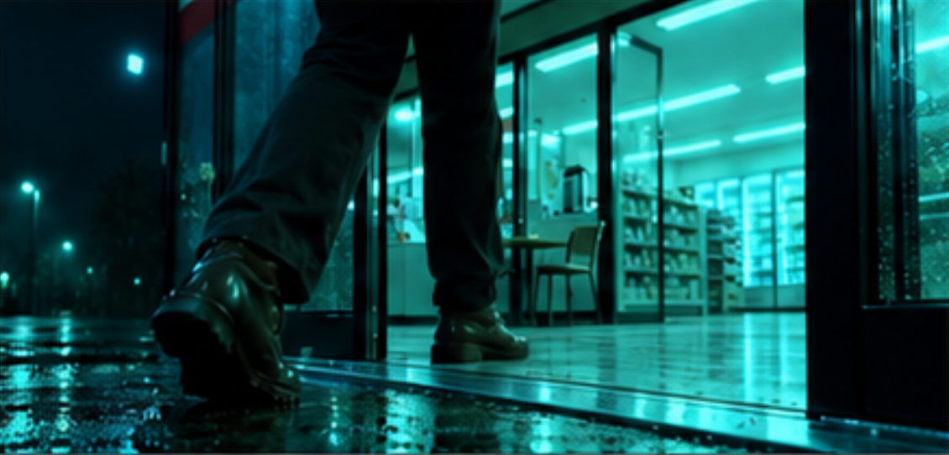
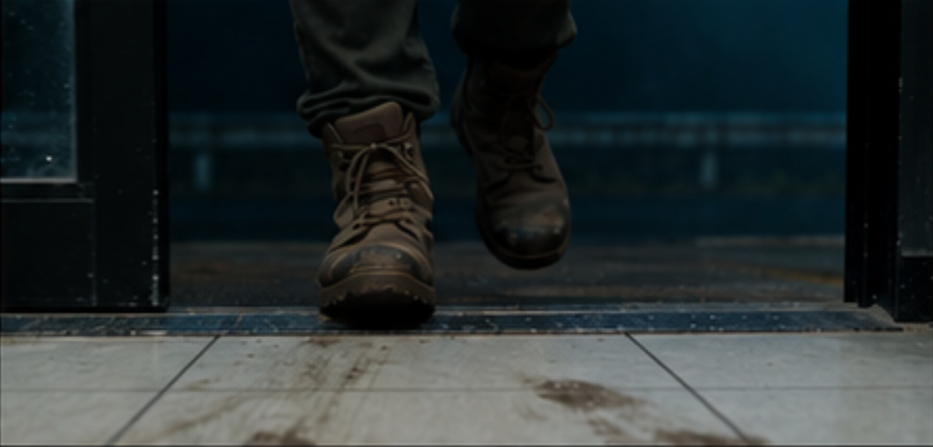
09
Shot 2: foot-level viewing direction
Requirement: a lateral foot-level view
Green-screen source
A: with video reference
B: without video reference
Filmed lateral foot view
A retains the side view.
B shows the feet frontally.
B changes the required viewing direction despite retaining feet in the frame.
ICCT 2026
09
Notes:
For Shot 2, we wanted to shoot the feet from the side.
Workflow A kept the side view, but B showed the feet from the front.
Both outputs included feet, but only A followed the required viewing direction.
Different shoes were acceptable because costume changes were part of the task.

Slide 10
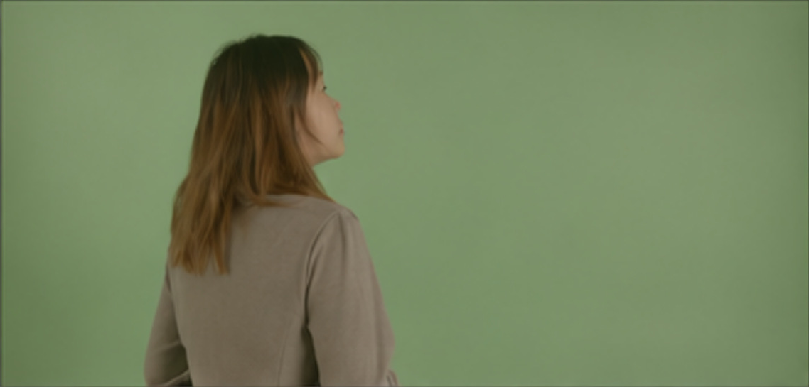
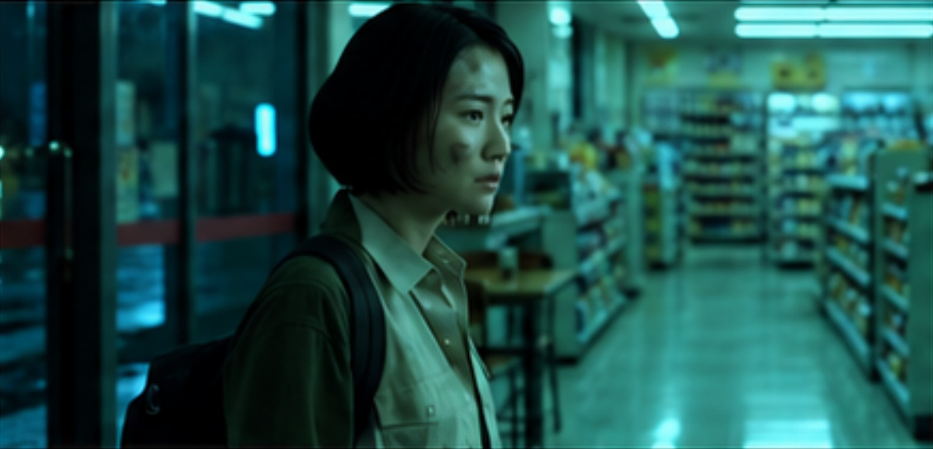
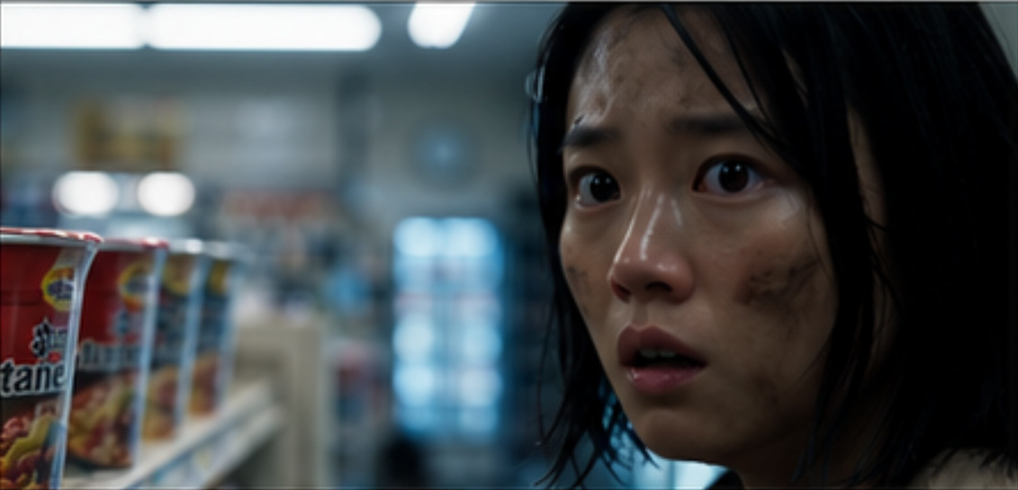
10
Shot 3: framing and viewpoint
Requirement: upper-body framing and the planned viewpoint
Green-screen source
A: with video reference
B: without video reference
Filmed realization
A retains upper-body framing
and the planned viewpoint.
B produces a tighter
facial close-up.
Full-clip review supports A’s compliance with the planned shot.
ICCT 2026
10
Notes:
Shot 3 required upper-body framing and the planned viewpoint.
A followed these requirements, but B produced a tighter facial close-up.
The assessment was based on the complete clips.
Color and visual finish were not assessment criteria.

Slide 11
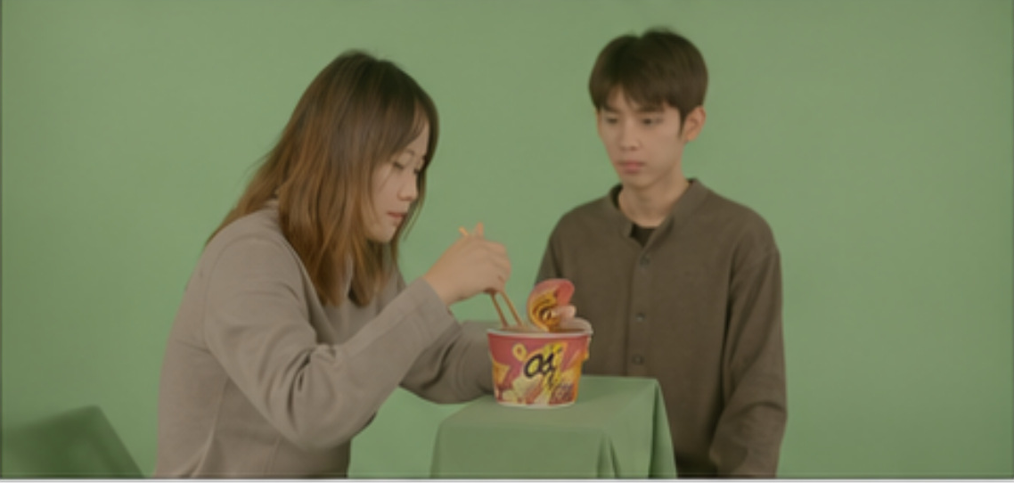
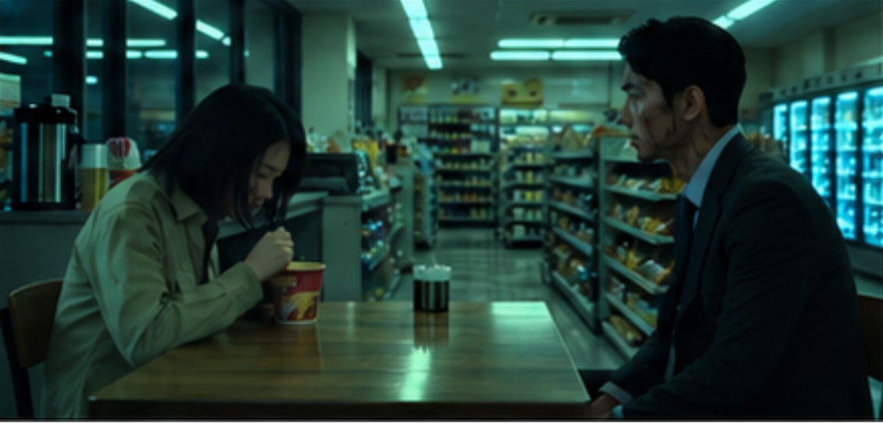
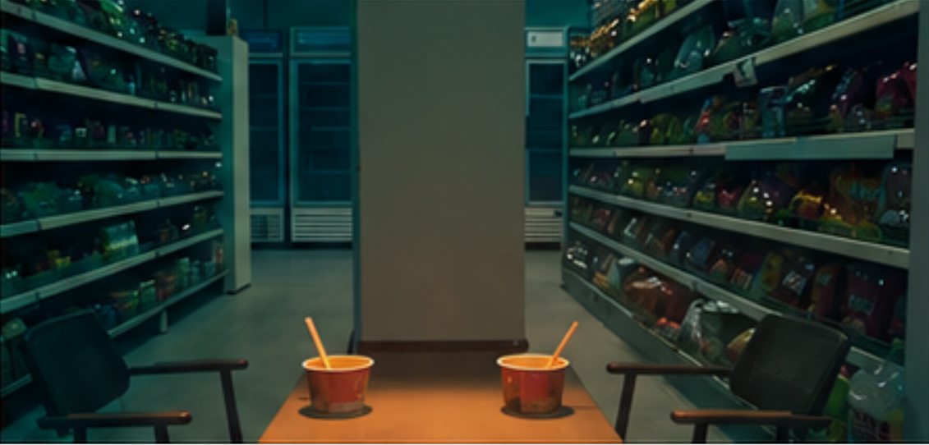
11
Shot 4: two-character presence
Requirement: both characters appear in the planned two-shot
Green-screen source
A: with video reference
B: without video reference
Filmed two-character setup
A retains both
required characters.
B omits both characters
throughout the complete clip.
Complete-clip review identifies whole-clip subject omission in B.
ICCT 2026
11
Notes:
Shot 4 required both characters to appear in the scene.
In A, both characters appeared, but their positions were different from the storyboard plan.
In B, neither character appeared anywhere in the complete clip.
The screenshot shows the empty scene. After watching the whole clip, I confirmed that both characters were missing throughout the video.

Slide 12
12
Interpretation and limitations
Interpretation
Video references provide a filmed realization of requirements described in shared text.
Evidence boundary | Consequence
Attempts and selection varied | First-attempt reliability remains unknown
One researcher selected and coded outputs | Possible selection and assessment bias
Five movement-path tasks | Limited evidence for movement
Additional information in A | Cannot isolate background or mechanism
Next validation: standardized sampling, independent assessment and generation records.
ICCT 2026
12
Notes:
The green-screen video helped keep the planned shot.
However, this study has several limitations.
Generation attempts and output selection were not standardized.
The same researcher selected and assessed the videos, so selection and assessment bias are possible.
Only five shot pairs were assessed for movement paths.
A also received extra information. We cannot isolate the effect of the green background or explain the model’s internal process.
Future studies need standard generation and selection rules, independent assessment, and complete generation records.

Slide 13
13
Conclusion
Added video references supported planned shot design
within the examined retained corpus.
25 / 30 vs 18 / 30
4 / 5 vs 2 / 5
26 / 28 vs 21 / 28
Framing and viewpoint
Movement path
Required subject presence
Shot acceptance requires storyboard-based review of the complete clip.
ICCT 2026
13
Notes:
To conclude, A met more storyboard requirements in the selected videos.
The four examples showed differences in framing, movement paths, viewing direction, and character presence.
These findings describe the sample examined in this study. They do not establish that A is generally the better workflow.
The main practical point is to check the complete video against the storyboard before accepting a shot.

Slide 14
14
Questions and discussion
Thank you for listening.
If you have any questions,
I would be happy to answer them.
ICCT 2026
14
Notes:
Thank you for listening. If you have any questions, I would be happy to answer them.

