Slide 1
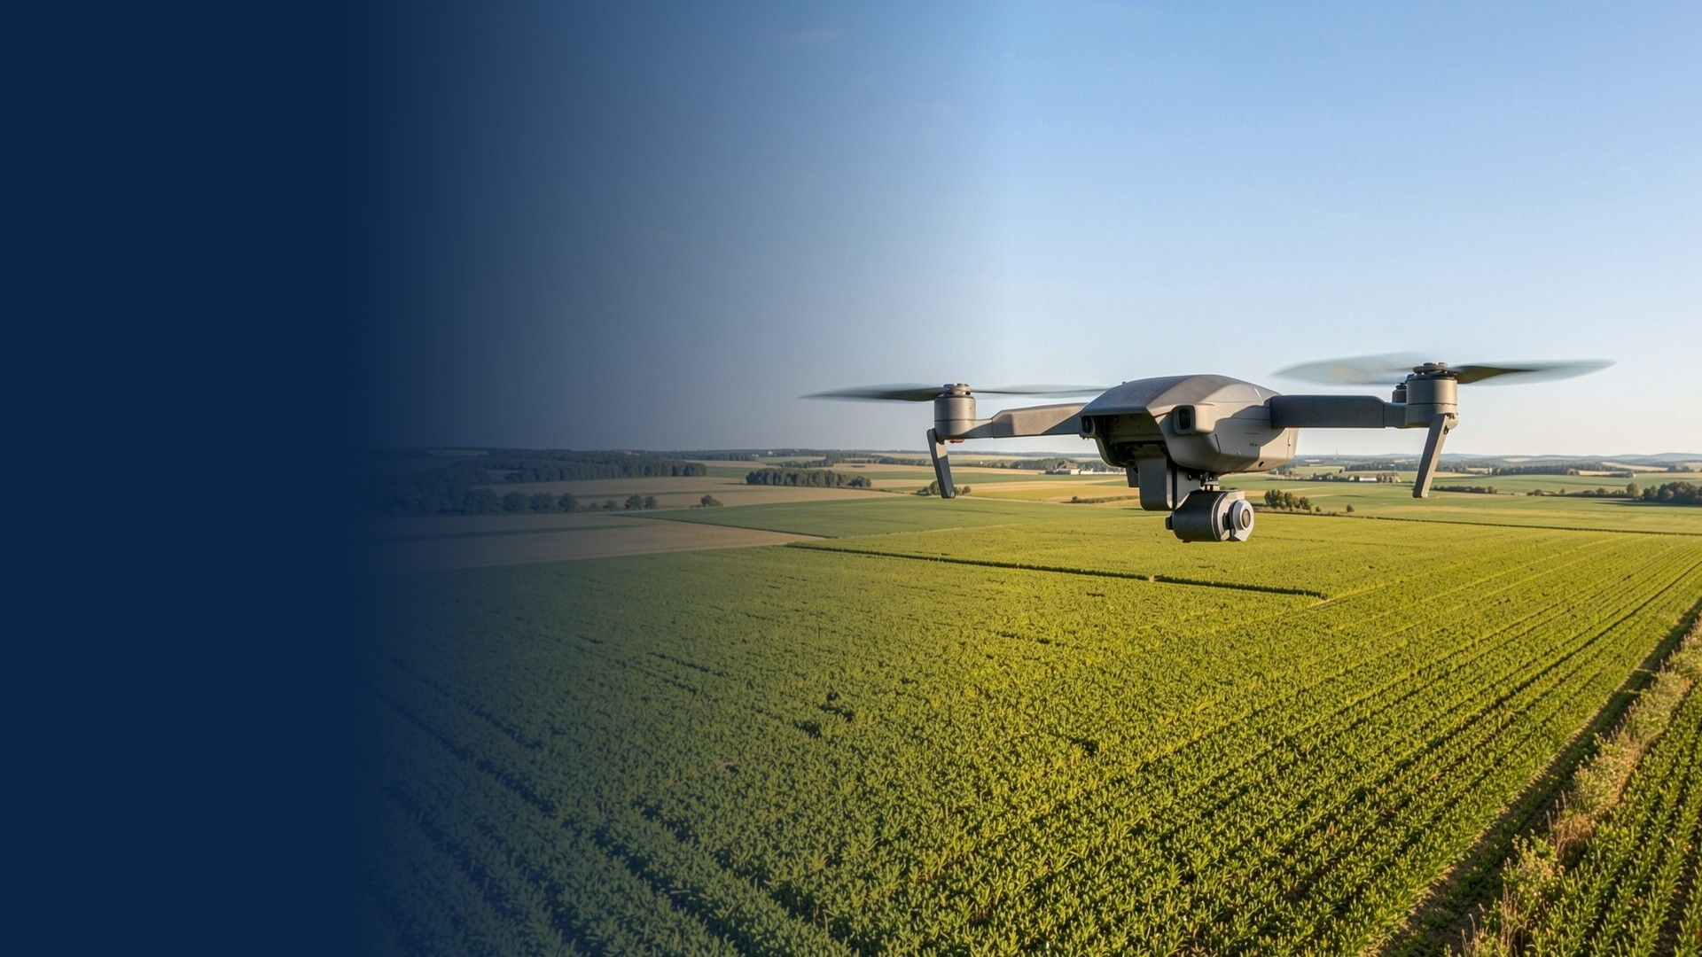
Lite-TemporalViT: Decoupled Spatial-Temporal Transformer for Ultra-Low Latency Aerial Drone Surveillance
ICCT · International Conference on Communication Technology
Sultan Mohyuddin · Muhammad Abubakar
Department of Computer Science, NFC IET, Multan, Pakistan
Mudassar Ali
College of Biomedical Engineering and Instrument Science, Zhejiang University, Hangzhou, China
Kamran Ali Memon · Muhammad Asghar Khan
Dept. Electrical Engineering, Prince Mohammad Bin Fahd University, Saudi Arabia
1.58 ms per clip · 1.28 M parameters
79.2% Top-1 accuracy
Notes:
Introduce the paper, the three authors and the headline result: a factorized hybrid video model that runs a 4-frame clip in 1.58 ms with 1.28 M parameters.

Slide 2




Why Drone Video Analysis Is Hard
Memory bandwidth
Narrow shared LPDDR memory; 3D tensor ops flood the onboard cache.
Power and heat
< 2 ms
Compute shares the battery with the motors; heat forces clock throttling.
per-clip latency target for safe autonomous flight, with minimal memory use
Latency is safety
Late vision data leaves less time to avoid obstacles and raises crash risk.
Notes:
Small drones need motion-aware vision on tiny processors. Memory, power/heat and latency are the three hard limits; sub-2 ms per clip is the target.

Slide 3



Where Existing Models Fall Short
2D CNNs
3D CNNs & Video Transformers
Lite-TemporalViT
Frame-by-frame processing
C3D, I3D, SlowFast, TimeSformer, ViViT
Factorized hybrid (ours)
Strength
Strength
Strength
Fast with minimal memory.
Capture spatial detail and motion together.
Multi-frame motion at near 2D-CNN speed.
Limitation
Limitation
Result
No motion cues: speed and direction changes are lost.
Heavy FLOPs, memory traffic and quadratic attention.
Compute grows linearly with clip length.
Notes:
2D CNNs are fast but lose motion; 3D CNNs and video transformers keep motion but are too heavy. Lite-TemporalViT sits between them.

Slide 4
Main Contributions
1
Decoupled Architecture
2
Sub-2 ms Latency
2D spatial extraction is separated from temporal tracking, so cost grows linearly with clip length.
1.58 ms per clip (~632 clips/s, ~2,528 FPS) with only 1.28 M parameters.
3
Reproducible Benchmarks
4
Extensive Ablations
Latency variability on T4, Jetson Orin Nano, Jetson Nano and Raspberry Pi 4.
Clip length, depth, precision and temporal attention maps are analysed.
Notes:
Four contributions: decoupled design, sub-2 ms latency, reproducible multi-hardware benchmarking, and detailed configuration tests.

Slide 5
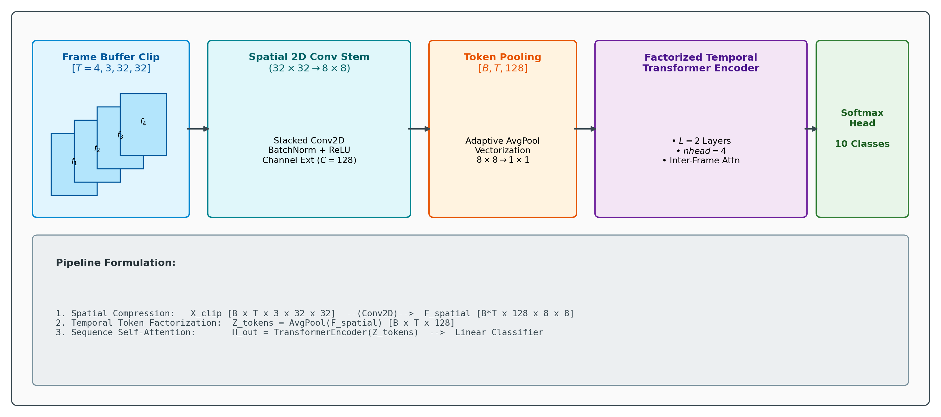
Architecture Overview
Fig. 1 End-to-end factorized spatio-temporal pipeline of Lite-TemporalViT.
Notes:
Four stages: frame buffer of T=4, 2D conv stem (32x32 to 8x8, 128 channels), token pooling to one 128-d token per frame, a 2-layer temporal transformer, and a softmax head.

Slide 6
Spatial Stem and Token Vectorization
Layer | Operation | Output shape | Params
Stem 1 | Conv2D (3→32), stride 1 | [B·T, 32, 32, 32] | 896
Stem 2 | Conv2D (32→64), stride 2 | [B·T, 64, 16, 16] | 18.4K
Stem 3 | Conv2D (64→128), stride 2 | [B·T, 128, 8, 8] | 73.8K
Token Pool | AdaptiveAvgPool2d (8×8→1×1) | [B, T, 128] | 0
Temp Enc | TransEnc (L = 2, nhead = 4) | [B, T, 128] | 1.18M
Head | MeanPool + Linear | [B, 10] | 1.29K
32×32 → 8×8
Three 3×3 conv layers expand channels to C′ = 128.
8×8 → 1×1
Adaptive average pooling gives one 128-d token per frame.
Layer-by-layer specification (Table I).
Notes:
Three 3x3 conv layers shrink 32x32 to 8x8 with 128 channels. Adaptive average pooling then gives one 128-d token per frame, removing spatial self-attention entirely. The temporal encoder holds 1.18 M of the 1.28 M parameters.

Slide 7
Factorized Temporal Transformer
Token 1
Temporal Transformer Encoder
L = 2 layers · 4 heads
d_{model} = 128
Attention only along T
Token 2
Mean pool
over T → B × 128
Linear + Softmax
10 classes
Token 3
Token 4
+ positional embeddings
Attention(Q, K, V) = Softmax(QK^{T} / √d_{k}) V
Self-attention runs only along the T = 4 frame axis.
O(T·d² + T²·d)
linear in spatial feature depth
Notes:
Attention runs only along the 4-frame axis, so cost is O(T d^2 + T^2 d): linear in feature depth, no quadratic spatial blow-up. Mean pooling over time feeds a linear softmax classifier.

Slide 8





Experimental Setup
Dataset
Training
Hardware
CIFAR-10 clips: T = 4 consecutive same-class samples
PyTorch, AdamW, lr 0.001, weight decay 0.01, 10 epochs
NVIDIA T4 on Google Colab; edge tests on Jetson and Raspberry Pi 4
Latency protocol
Power
Scope note
Batch size 1, TensorRT, 50 warm-up + 500 timed runs, CUDA event sync
15 W Max-N mode on Jetson, INA3221 monitors over 500 iterations
CIFAR-10 is a controlled testbed; UCF101 / UAV123 validation is planned
Notes:
All models share identical training and benchmarking conditions. CIFAR-10 is a controlled testbed; validation on UCF101 or UAV123 is future work.

Slide 9
Accuracy and Efficiency vs. Baselines
91.0%
+2.1%
1.58 ms
smaller than 3D-ResNet18
Top-1 over 3D-ResNet18
vs 2.85 ms for ViViT-Tiny
Notes:
Lite-TemporalViT is smallest, fastest and most accurate: 91.0% fewer parameters than 3D-ResNet18 with +2.1 points of accuracy, and 1.58 ms versus 2.85 ms for ViViT-Tiny.

Slide 10
Edge Hardware Profiling
INT8 (green bars): 242 clips/s at 3.2 W on Jetson Nano 4GB, and 81 clips/s (324 FPS) at 1.8 W on a CPU-only Raspberry Pi 4.
Notes:
Across T4, Jetson Orin Nano, Jetson Nano 4GB and Raspberry Pi 4, INT8 quantization makes real-time operation possible on very low-power hardware.

Slide 11
Ablation and Precision Analysis
Mode | Size | VRAM | Latency | Top-1
FP32 | 5.12 | 18.4 | 2.45 ms | 79.3%
FP16 (ours) | 2.56 | 9.2 | 1.58 ms | 79.2%
INT8 | 1.28 | 4.8 | 0.98 ms | 78.4%
Precision scaling (Table V); size and VRAM in MB.
Longer buffer (T = 2 → 4) adds +4.4% accuracy for +0.66 ms; doubling depth to L = 4 adds only +0.4%.
FP16 cuts latency 35.5% vs FP32 at −0.1 pt accuracy; INT8 reaches 0.98 ms.
Notes:
T=4, L=2 is the sweet spot. T=8 gains accuracy but exceeds 2 ms; L=4 doubles parameters for +0.4 points. FP16 halves memory with almost no accuracy loss; INT8 reaches 0.98 ms.

Slide 12
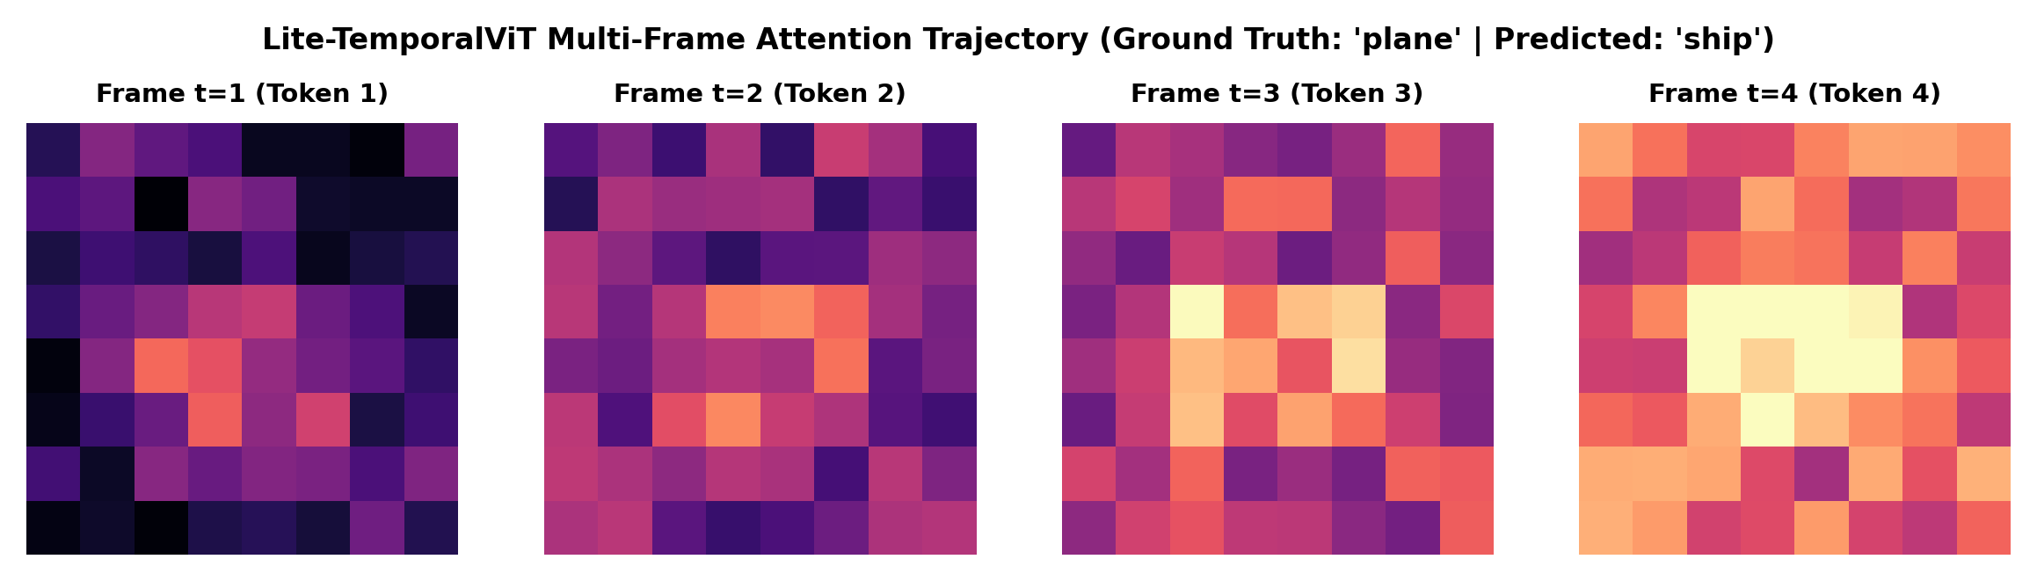
Convergence and Temporal Attention
Fig. 2 Multi-frame temporal activation trajectory across frames t = 1 to t = 4.
52.4% → 79.2%
1.310 → 0.589
t = 1 → 4
validation accuracy, epoch 1 → 10
validation loss, epoch 1 → 10
attention focuses on motion
Notes:
Validation accuracy rises from 52.4% to 79.2% over 10 epochs with smooth loss reduction. Heatmaps show the attention concentrating on active motion regions as frames progress.

Slide 13

Conclusion and Deployment Outlook
Key takeaways
Deployment
79.2% Top-1 with 1.28 M parameters and 1.58 ms per 4-frame clip on a T4 GPU.
Low heat (0.22 GFLOPs): less clock throttling on long missions
Small footprint (2.56 MB) allows a dual-stream fail-safe pipeline
Fine-tune with domain augmentations for shake and lighting
Ahead of 3D-ResNet18, SlowFast-Lite and ViViT-Tiny on every metric in Table II.
Future work
INT8 runs in real time on Jetson Nano (242 clips/s, 3.2 W) and Raspberry Pi 4 (81 clips/s).
INT8 on embedded flight hardware and dual-stream tests in real drone flights.
Notes:
Summarise the three takeaways, then the deployment considerations and the future work: INT8 on embedded flight hardware and dual-stream tests in real flights.

Slide 14
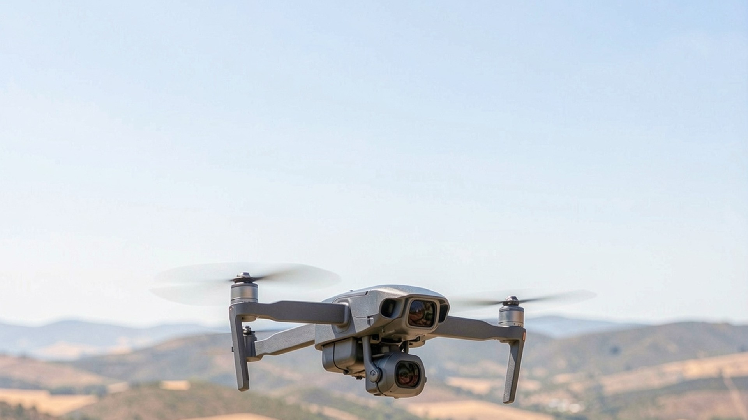
Thank You
Questions and discussion
Sultan Mohyuddin · sultansindhu22@gmail.com
Muhammad Abubakar · muhammadabubakar19.cs@gmail.com
Mudassar Ali · mudassar.ali@zju.edu.cn
Kamran Ali Memon · kali@pmu.edu.sa
Muhammad Asghar Khan · mkhan4@pmu.edu.sa
Code and evaluation scripts available upon request.
Notes:
Invite questions. Contact details are from the paper.

