Slide 1

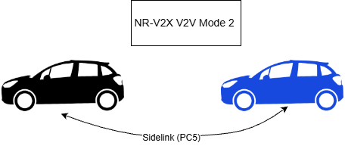
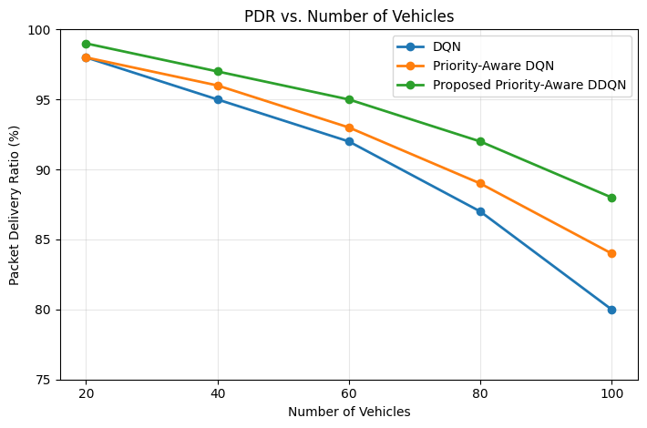
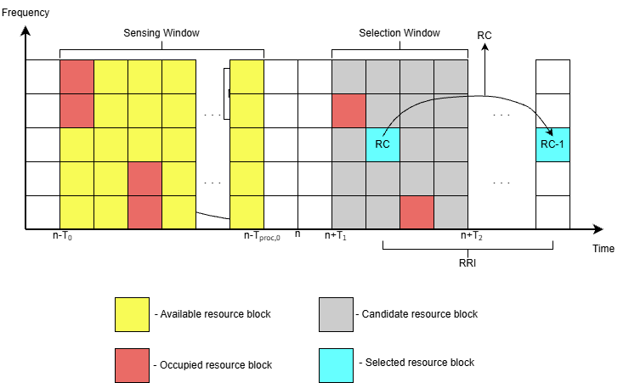
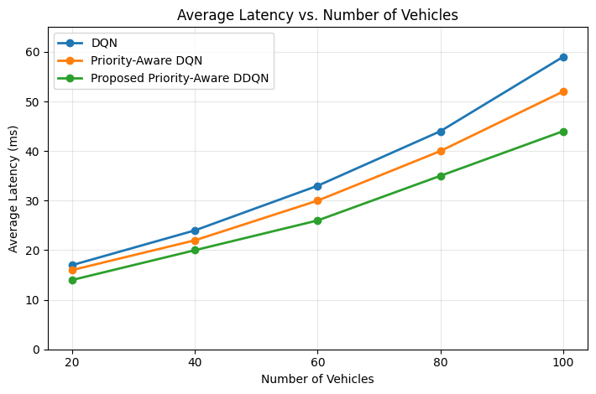
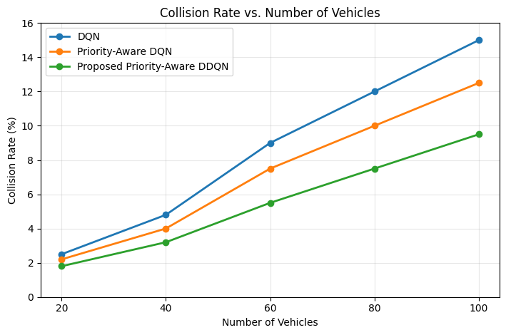
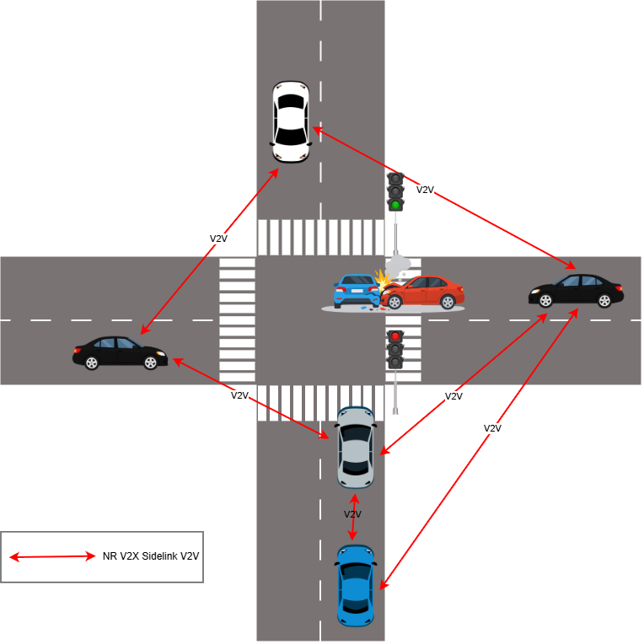
Priority-Aware Sidelink Resource Allocation
in NR-V2X Networks Using a Double Deep Q-Network
Sunghyun Kim*, Diana Dyussembayeva*, Muhammad Azfar Yaqub**, Dongkyun Kim*
*Kyungpook National University **Free University of Bozen-Bolzano
sunghyunkim@knu.ac.kr, dyussembayevadiana@gmail.com, Muhammadazfar.yaqub@unibz.it, dongkyun@knu.ac.kr
SUMMARY
In NR-V2X sidelink Mode 2, vehicles autonomously select and reserve transmission resources through sensing-based semi-persistent scheduling (SB-SPS). At a dense urban intersection, vehicles detecting the same accident may simultaneously select the same idle subchannel, causing resource collisions. We propose Priority-Aware Double Deep Q-Network (DDQN) resource selection that incorporates message urgency and local resource conditions while retaining SB-SPS sensing and candidate generation. Research-defined weights distinguish CAM, CPM, and DENM traffic and modulate the reward for successful transmission. With 100 vehicles, the proposed method achieves 88% packet delivery ratio (PDR), 44 ms average latency, and 9.5% collision rate. Compared with DQN, this corresponds to an 8-percentage-point PDR gain, 25.4% lower latency, and 36.7% lower collision rate.
INTRODUCTION
PROPOSED SCHEME
NR-V2X V2V Sidelink Mode 2
Priority-Aware DDQN Resource Selection
Vehicles communicate directly through the PC5 interface, including outside network coverage.
Vehicles autonomously select transmission resources from configured or preconfigured sidelink pools.
Retain SB-SPS sensing and candidate generation.
Message weights: CAM 0.5, CPM 0.7, DENM 1.0
Research-defined QoS policy values, distinct from standardized sl-Priority.
State: sᵢ(t) = [wᵢ, Vᵢ, Qᵢ, Fᵢ]
wᵢ: message priority, Vᵢ: nearby-vehicle density,
Qᵢ: queue state, Fᵢ: future reservations inferred from SCI.
Action: aᵢ(t) ∈ {1, 2, …, Kᵢ}
Reward: Rᵢ(t) = λₛ(1 + αwᵢ)Sᵢ(t)
DDQN separates online action selection from target-value evaluation. Message urgency scales the success reward.
Fig. 1. NR-V2X sidelink communication in V2V Mode 2.
Fig. 4. PDR
V2V Messages and Resource Reservation
PDR at 100 vehicles
CPM: sensor-based perception. CAM: periodic vehicle status.
DENM: aperiodic hazard notifications.
SB-SPS senses the preceding 1 s and uses a resource reselection counter (RC) and resource reservation interval (RRI).
88%
8 percentage
points higher
than DQN
DQN: 80%
Priority-Aware DQN: 84%
Fig. 5. Latency
Average at 100 vehicles
44 ms
25.4% lower
than DQN
DQN: 59 ms
Priority-Aware DQN: 52 ms
Fig. 2. Sidelink subchannel sensing and reservation in Mode 2.
Fig. 6. Collision rate
PROBLEM DEFINITION
Rate at 100 vehicles
Simultaneous Emergency Resource Selection
9.5%
Simultaneous selection of an idle subchannel can create duplicate reservations.
Resulting collisions reduce PDR and increase emergency-message latency.
36.7% lower
than DQN
DQN: 15.0%
Priority-Aware DQN: 12.5%
NS-3 Simulation Settings
CONCLUSION
Parameter | Value
Area | 500 × 500 m
Vehicles | 20–100
Bandwidth | 20 MHz
Subchannels | 10
Tx power | 20 dBm
Duration | 240 s
Priority-Aware DDQN incorporates message urgency and local resource conditions while retaining SB-SPS sensing and candidate generation. The method improves PDR and lowers latency and collision rate under the evaluated conditions. Relative to Priority-Aware DQN at 100 vehicles, latency and collision rate decrease by 15.4% and 24.0%, respectively.
Baselines: DQN and
Priority-Aware DQN
Vehicle counts: 20, 40,
60, 80, and 100
Future Work
Evaluate simultaneous DENM bursts in a standards-based NR-V2X PHY/MAC environment. Measure message-specific PDR, latency distributions, and delivery probability within the deadline.
Fig. 3. V2V communication following event detection at an urban intersection.
Notes:
Source: ICCT2026_English(1).docx. Sections I, III, IV, and V; original Figs. 1–6; Eqs. (2), (3), (5), and (7); Table I.

